Slide 1
C Programming
Chapter 4

Slide 2
C Relational operators
A relational operator checks the relationship between two operands. If the relation is true, it returns 1; if the relation is false, it returns value 0.
Relational operators are used in decision making and loops.

Slide 3
Operator | Meaning of Operator | Example
== | Equal to | 5 == 3 is evaluated to 0
> | Greater than | 5 > 3 is evaluated to 1
< | Less than | 5 < 3 is evaluated to 0
!= | Not equal to | 5 != 3 is evaluated to 1
>= | Greater than or equal to | 5 >= 3 is evaluated to 1
<= | Less than or equal to | 5 <= 3 is evaluated to 0

Slide 4
Practice with Relational Expressions
int a = 1, b = 2, c = 3 ;
Expression Value Expression Value
a < c a + b >= c
b <= c a + b == c
c <= a a != b
a > b a + b != c
b >= c
T
T
T
T
F
T
F
F
F

Slide 5
C Logical Operators
An expression containing logical operator returns either 0 or 1 depending upon whether expression results true or false.
Logical operators are commonly used in decision making in C programming.

Slide 6
C Logical Operators contd…
Sometimes we need to test multiple conditions in order to make a decision.
Logical operators are used for combining simple conditions to make complex conditions.

Slide 7
Operator | Meaning of Operator | Example
&& | Logical AND. True only if all operands are true | If c = 5 and d = 2 then, expression ((c==5) && (d>5)) equals to 0.
|| | Logical OR. True only if either one operand is true | If c = 5 and d = 2 then, expression ((c==5) || (d>5)) equals to 1.
! | Logical NOT. True only if the operand is 0 | If c = 5 then, expression !(c==5) equals to 0.

Slide 8
Practice question
Given
int a = 5, b = 7, c = 17 ;
evaluate each expression as True or False.
1. c / b == 2
2. c % b <= a % b
3. b + c / a != c - a
4. (b < c) && (c == 7)
5. (c + 1 - b == 0) || (b = 5)

Slide 9
Bitwise operators in C
In arithmetic-logic unit (which is within the CPU), mathematical operations like: addition, subtraction, multiplication and division are done in bit-level.
To perform bit-level operations in C programming, bitwise operators are used.

Slide 10
Operator | Meaning of Operator
& | Bitwise AND
| | Bitwise OR
^ | Bitwise XOR
~ | Bitwise complement
<< | Shift left
>> | Shift right

Slide 11
Bitwise AND
The output of bitwise AND is 1 if the corresponding bits of two operands is 1. If either bit of an operand is 0, the result of corresponding bit is evaluated to 0.

Slide 12
Bitwise AND
12 = 00001100 (In Binary)
25 = 00011001 (In Binary)
Bit Operation of 12 and 25
00001100
& 00011001
________
00001000 = 8 (In decimal)

Slide 13
Bitwise AND example
#include <stdio.h>
int main()
{
int a = 12, b = 25;
printf("Output = %d", a&b);
return 0;
}
//output 8

Slide 14
Bitwise OR
The output of bitwise OR is 1 if at least one corresponding bit of two operands is 1.
In C Programming, bitwise OR operator is denoted by |.

Slide 15
Bitwise OR
12 = 00001100 (In Binary)
25 = 00011001 (In Binary)
Bit Operation of 12 and 25
00001100
& 00011001
________
00011101 = 29 (In decimal)

Slide 16
Bitwise OR example
#include <stdio.h>
int main()
{
int a = 12, b = 25;
printf("Output = %d", a|b);
return 0;
}
//output 29

Slide 17
Bitwise XOR (exclusive OR) operator ^
The result of bitwise XOR operator is 1 if the corresponding bits of two operands are opposite.
It is denoted by ^.

Slide 18
Bitwise XOR (exclusive OR) operator ^
12 = 00001100 (In Binary)
25 = 00011001 (In Binary)
Bitwise XOR Operation of 12 and 25
00001100
^ 00011001
________
00010101 = 21 (In decimal)

Slide 19
Example: Bitwise XOR
#include <stdio.h>
int main()
{
int a = 12, b = 25;
printf("Output = %d", a^b);
return 0;
}
//output 21

Slide 20
Bitwise complement operator
Bitwise compliment operator is an unary operator (works on only one operand).
It changes 1 to 0 and 0 to 1. It is denoted by ~.

Slide 21
Bitwise complement operator
35 = 00100011 (In Binary)
Bitwise complement Operation of 35
~ 00100011
________
11011100 = 220 (In decimal)

Slide 22
Bitwise complement operator
35 = 00100011 (In Binary)
Bitwise complement Operation of 35
~ 00100011
________
11011100 = 220 (In decimal)

Slide 23
Bitwise complement operator
The bitwise complement of 35 (~35) is -36 instead of 220, but why?
For any integer n, bitwise complement of n will be -(n+1).
To understand this, you should have the knowledge of 2's complement.

Slide 24
2's Complement
The 2's complement of a number is equal to the complement of that number plus 1. For example:
Decimal: 220 Binary: 11011100 -(00100011+1) [-(n+1)]
= -00100100
= -36(decimal)

Slide 25
Bitwise complement operator
The bitwise complement of 35 is 220 (in decimal). The 2's complement of 220 is -36. Hence, the output is -36 instead of 220.

Slide 26
Example bitwise complement
#include <stdio.h>
int main()
{
int a=35,b=-12;
printf("Output = %d\n",~a);
printf("Output = %d\n",~b);
return 0;
}//output -36,11

Slide 27
Shift operators in C
There are two shift operators in C programming:
Right shift operator
Left shift operator.

Slide 28
Right Shift Operator
Right shift operator shifts all bits towards right by certain number of specified bits.
It is denoted by >>.

Slide 29
Right shift operator
220 11011100 (220)
220 >> 2 00110111 (55)

Slide 30
Example right shift operator
#include <stdio.h>
int main()
{
int num=220;
printf("right shift 220 by 2 bits %d",num>>2);
return 0;
}

Slide 31
Left shift operator
Left shift operator shifts all bits towards left by a certain number of specified bits.
The bit positions that have been vacated by the left shift operator are filled with 0.
The symbol of the left shift operator is <<.

Slide 32
Left shift operator
220 11011100 (220)
220 << 2 11011100 00 (880)

Slide 33
Example left shift operator
#include <stdio.h>
int main()
{
int num=220;
printf("right shift 220 by 2 bits %d",num<<2);
return 0;
}//output 880

Slide 34
Comma as an operator
Sometimes we assign multiple values to a variable using comma, in that case comma is known as operator.
Example:
a = 10,20,30;
In the above statement, value of a will be 10, because assignment operator (=) has more priority more than comma (,), thus 10 will be assigned to the variable a.

Slide 35
Comma as an operator
Sometimes we assign multiple values to a variable using comma, in that case comma is known as operator.
Example:
b = (10,20,30);
In the second statement, value of b will be 30, because 10, 20, 30 are enclosed in braces, and braces has more priority than assignment (=) operator. When multiple values are given with comma operator within the braces, then right most value is considered as result of the expression. Thus, 30 will be assigned to the variable b.

Slide 36
Comma as an operator
#include <stdio.h>
int main()
{
int a,b;
a = 10,20,30;
b = (10,20,30);
//printing the values
printf("a= %d, b= %d\n",a,b);
return 0;
}

Slide 37
Comma as a separator
Comma acts as a separator when used with function calls and definitions, function like macros, variable declarations, enum declarations, and similar constructs.
Example
int a = 1, b = 2;
void fun(x, y);

Slide 38
Conditional Operator in C
The conditional operator is also known as a ternary operator. The conditional statements are the decision-making statements which depends upon the output of the expression.
It is represented by two symbols, i.e., '?' and ':'.
The behavior of the conditional operator is similar to the 'if-else' statement.

Slide 39
Syntax: conditional operator
Syntax of a conditional operator
Expression1? expression2: expression3;
(condition ? value_if_true : value_if_false)

Slide 40
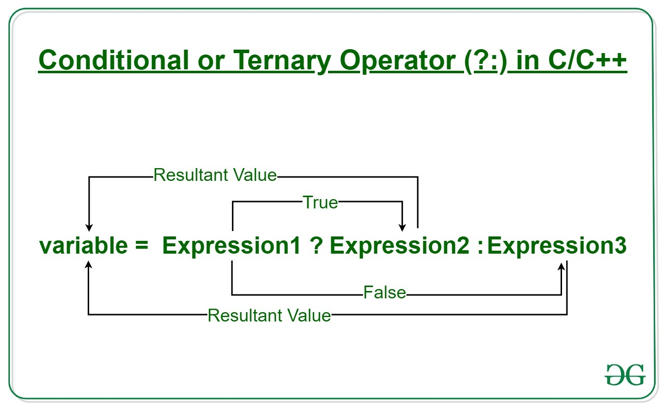
Syntax: conditional operator

Slide 41
Example conditional operator
#include <stdio.h>
int main()
{
int a = 10, b = 20, c;
c = (a < b) ? a : b;
printf(“c = %d", c);
return 0;
}

Slide 42
Nested conditional operator
#include <stdio.h>
int main()
{
float unit_price = 10.0, dis1 = 0.05, dis2 = 0.1, dis3 = 0.15, total_price;
int qty = 11;
total_price = qty*unit_price*(1.0 -
(qty>50 ? dis1 : (
qty>20 ? dis2 : (
qty>10 ? dis3 : 0.0))));
printf("The total price is %.2f\n", total_price);
return 0;
}

Slide 43
Conditional (ternary) operator
As we know that the behavior of conditional operator and 'if-else' is similar but they have some differences. Let's look at their differences.
Conditional operator is a single statement where if-else comes in a block.
We can use conditional operator to assign values to a variable whereas it is not possible in if-else
Not useful for executing multiple statements, whereas it is easy in if-else.
Nested ternary operator is more complex and cannot be easily debugged, while the nested 'if-else' statement is easy to read and maintain.

Slide 44
Type casting
Type casting refers to changing an variable of one data type into another.
Implicit type casting
Explicit type casting

Slide 45
Implicit Type Conversion
When the type conversion is performed automatically by the compiler without programmers intervention, such type of conversion is known as implicit type conversion or type promotion.

Slide 46
Example Implicit Type Conversion
#include<stdio.h>
int main(){
int x=97;
printf("%c", x);
/*Implicit casting from int to char */
return 0;
}// output a

Slide 47
Explicit Type Conversion
The type conversion performed by the programmer by posing the data type of the expression of specific type is known as explicit type conversion. The explicit type conversion is also known as type casting.

Slide 48
Explicit Type Conversion
Type casting in c is done in the following form:
(data_type)expression;

Slide 49
Example explicit type conversion
int x=7, y=5;
float z;
z = (float)x/(float)y;
/*Here the value of z is 1.4*/

